Slide 1
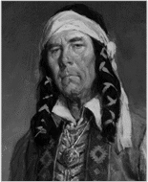
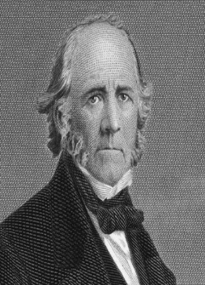
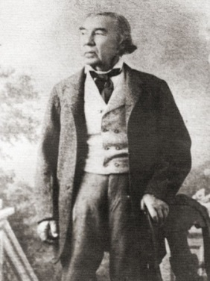
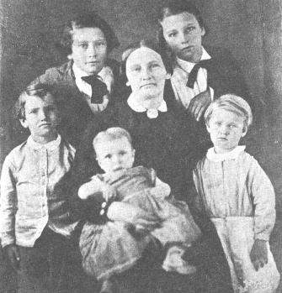
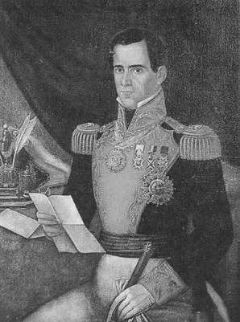
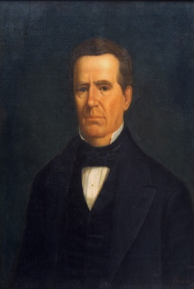
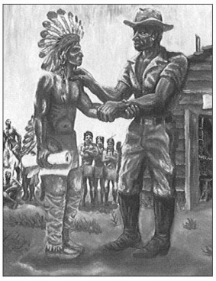
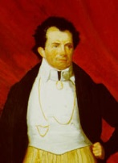
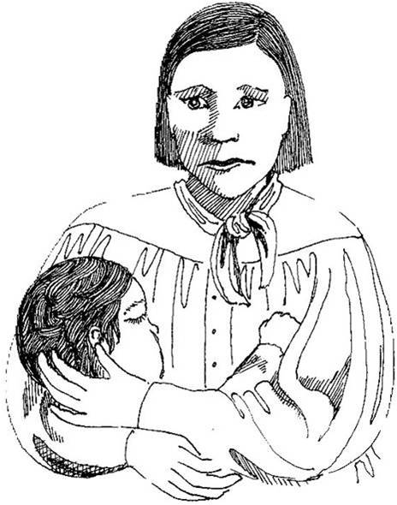
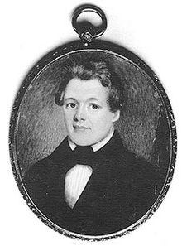
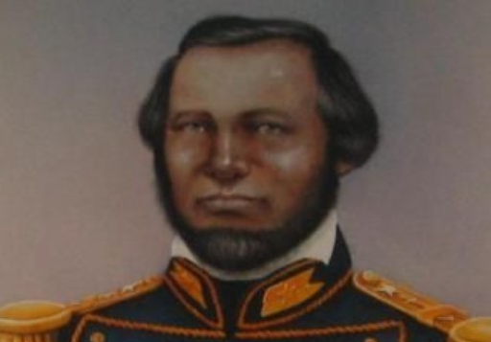
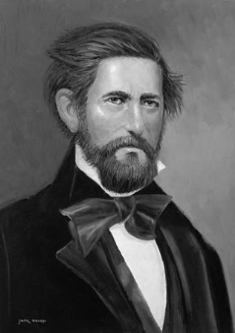
Faces of the Republic

Slide 2
My name is William Goyens
Early Free Black Nacogdoches Settler
Wealthy trader and blacksmith who helped Sam Houston negotiate a treaty with the Cherokee Indians
2 bullets

Slide 3
My name is Mary Maverick
Pioneer woman during the early Republic of Texas.
Her family fled the Woll Invasion in 1842.
Kept diaries of her pioneer life for future generations
Painted a picture of the Alamo
Saw the Alamo fall
5 bullets

Slide 4
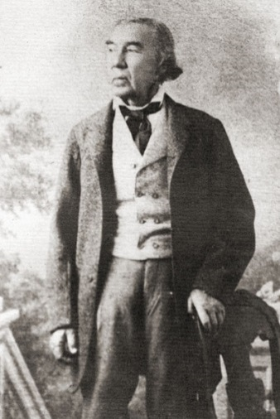
My name is Jose Antonio Navarro
Helped write Texas’s first constitution.
Commissioner sent with the failed Santa Fe Expedition.
The only Tejano at the Convention of 1845 to decide whether to accept the U.S. annexation offer.
1 of 3 Mexicans to sign the Texas Declaration of Independence.
Elected to the Texas senate twice
5 bullets

Slide 5
My name is Cynthia Ann Parker
Kidnapped by Comanche Indians as a girl.
Married a Comanche war-chief.
Her son was Quannah Parker – one of the most powerful Comanche Chiefs.
3 bullets

Slide 6
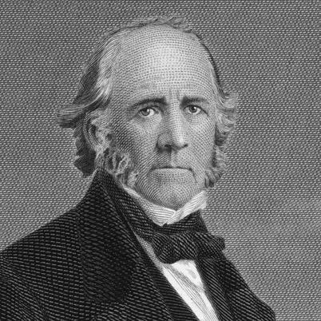
My name is Sam Houston
1st and 3rd President of Texas (couldn’t serve 2 consecutive terms)
Sold the Texas Navy
Favored peace with the Native Americans
Would have rather stayed a soldier than be president
Resolved the Regulator-Moderator War
Convinced European nations to recognize TX as an independent nation
5 bullets

Slide 7
My name is Edwin Moore
Commander of the Texas Navy
Took control of the Gulf of Mexico from the Mexican Navy in 1841
Accused by Sam Houston of disobedience and removed from the Texas Navy
3 bullets

Slide 8
My name is Chief Bowles
Cherokee Chief
Led his people from North Carolina to Texas near Nacogdoches
Negotiated a treaty with Sam Houston to allow his tribe to stay in East Texas
Was killed at the Battle of the Neches trying to prevent his tribe from being expelled from Texas.
4 bullets

Slide 9
My name is Mirabeau B. Lamar
2nd president of Texas
Favored Texas staying a Republic
Removed the Cherokees from Texas
Aggressive toward Native Americans
Rebuilt the Texas Navy
Sent an expedition to Santa Fe to add it to the Republic of Texas
Relocated the Texas capital to Austin
7 bullets

Slide 10
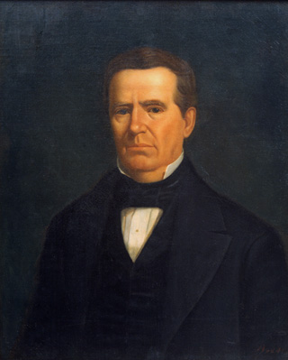
My name is Anson Jones
4th president of Texas
Architect of Annexation
Said, “The Republic of Texas is no more.”
3 bullets

Slide 11
My name is George Childress
Wrote the Texas Declaration of Independence
Tried to have a law office but failed
2 bullets

Slide 12
My name is Santa Anna
President of Mexico
Captured at the Battle of San Jacinto
Did not keep his promises he made in Treaties of Velasco
3 bullets

Slide 13
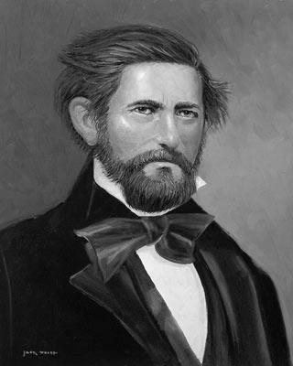
My name is Jack “Coffee” Hays
Texas Ranger
Patrolled the frontier
Protected Texas settlers
Kept peace with Native American tribes
4 bullets

Slide 14
Presidents of Texas
Houston → 1836 – 1838
Lamar → 1838 – 1841
Houston → 1841 – 1844
Jones → 1844 – 1845

