Slide 1
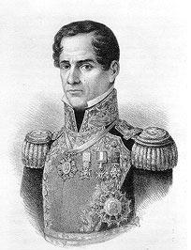
SANTA ANNA
President/Dictator of Mexico (eleven times) and Commander of MX Armies
Led attack and defeated TX at Battle of Alamo
He was captured by Houston and defeated at Battle of San Jacinto
Died in poverty

Slide 2
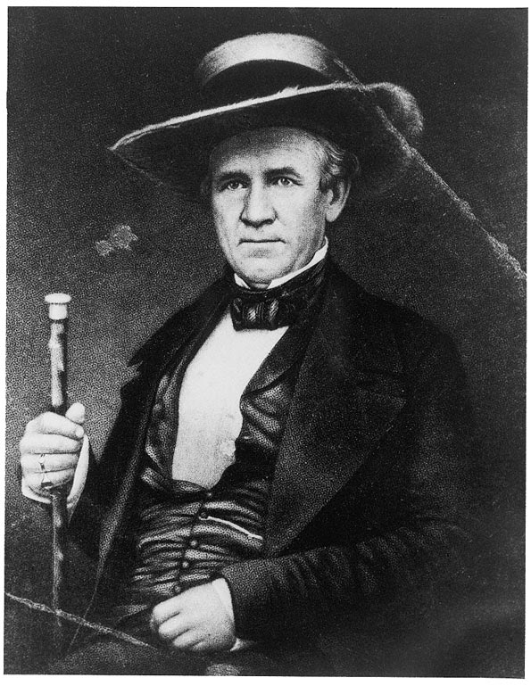
SAM HOUSTON
Commander in Chief of TX Armies
Constitution of 1836 named him overall Commander of TX Armies
After Alamo defeat, he trained all TX armies
Was not always popular b/c he refused to fight
He strategically fought at right moment, and defeated Santa Anna at Battle of San Jacinto winning TX its independence
Later became TX first and third president

Slide 3
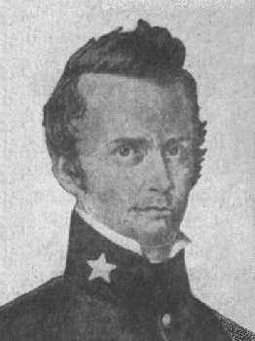
WILLIAM TRAVIS
Lieutenant Colonel of TX Regular Army at Battle of Alamo
Arrested at Anahuac
Part of War Party at Consultation
Commander at Alamo after Bowie became too sick
Sent famous letter for help
Killed at Alamo

Slide 4
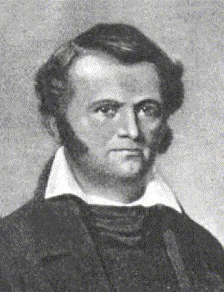
JAMES BOWIE
Commander of Private Army
Had reputation as a good knife fighter (Bowie knife)
Married daughter of vice governor of TX
Died in his bed at Alamo, too sick to fight, passed command to Travis

Slide 5
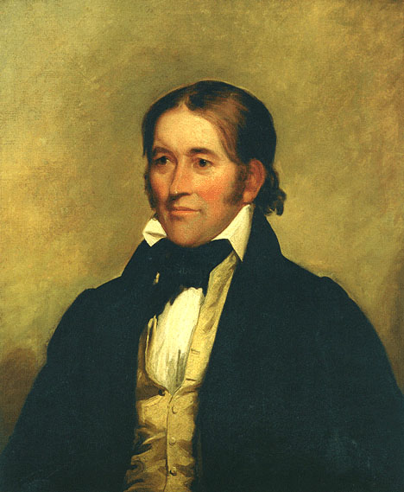
DAVID CROCKET
Frontiersman, TN Congressman
Claimed to kill 100 bears in one year
Fought among privates at Alamo although offered a commander position
One of few to survive Alamo but later executed
Fought with Travis and Bowie

Slide 6
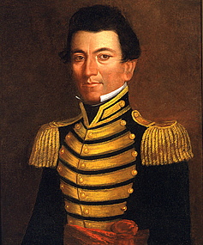
JUAN SEGUIN
Tejano Captain in TX Army
Tejano – of MX descent but loyal to TX and considers it home
Wealthy landowner
Sent to search for recruits (help) during Alamo so he survived
Helped Houston win at Battle of San Jacinto

Slide 7
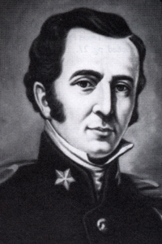
JAMES FANNIN
Commander of TX Army at Goliad (Massacre)
Fought at Battle of Gonzalez in Oct 1835
April 1836, was in charge of 450 troops at Battle of Goliad
Houston ordered him to retreat
He delayed which caused his surrender and execution of all troops (Goliad Massacre)

Slide 8
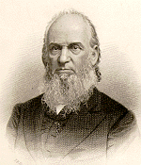
DAVID BURNET
Ad Interim President of TX during Revolution
Member of 1833 Convention
Involved in Convention of 1836 that drafted TX declaration of independence

Slide 9
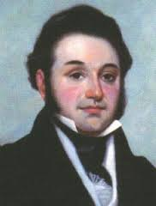
LORENZO DE ZAVALA
Ad Interim (temporary) Vice-President of Republic of TX
March 2, 1836
Washington-on-Brazos
Texas’ needed a temporary gov’t set up quickly b/c the Battle of the Alamo was being fought in San Antonio
David Burnet was ad interim President

Slide 10
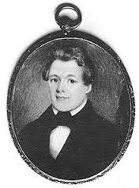
GEORGE CHILDRESS
Primary Author of TX DECLARATION OF INDEPENDENCE
Had 4 other co-writers
March 2, 1836
Washington-on-Brazos
Literally written overnight b/c the Battle of the Alamo was being fought in San Antonio
Texas’ needed a temporary gov’t set up quickly
Had a lot of same features as US Dec of Independence

