Slide 1
Presidents of Texas

Slide 2
Duties of the President
To make the laws for the republic
To explain and interpret the laws
To carry out, or implement the laws

Slide 3
The Presidents of Texas
Sam Houston 1836 – 1838
Mirabeau Lamar 1838 – 1841
Sam Houston 1841 – 1844
Anson Jones 1844 - 1846

Slide 4
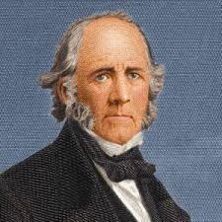
Sam Houston
1st & 3rd President of Texas
Would rather stay a soldier than become President
Worked to improve relations with treaties and negotiation
Designated Houston as the capital of TX
Sent most of the army home to save money
Wanted Texas to be annexed to the U.S.
Not reelected right away because the Constitution limited a president’s powers by prohibiting two consecutive terms of office.

Slide 5
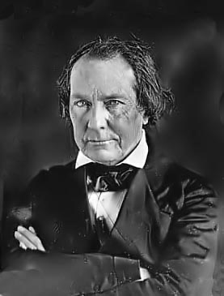
Mirabeau Lamar
2nd President of Texas
Aggressive towards Native Americans
Relocated the capital of Texas to Austin
Built up the Navy
Did not want to be annexed into the U.S.

Slide 6
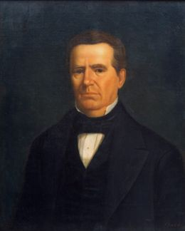
Anson Jones
4th President of Texas
Last President of the Republic of Texas
Nickname: Architect of Annexation
Said “the Republic of Texas is no more”

