Slide 1
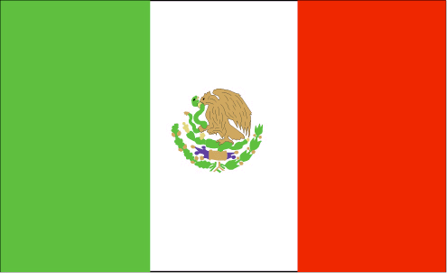

MEXICAN REVOLUTION
1810 - 1821
Mexico vs. Spain

Slide 2

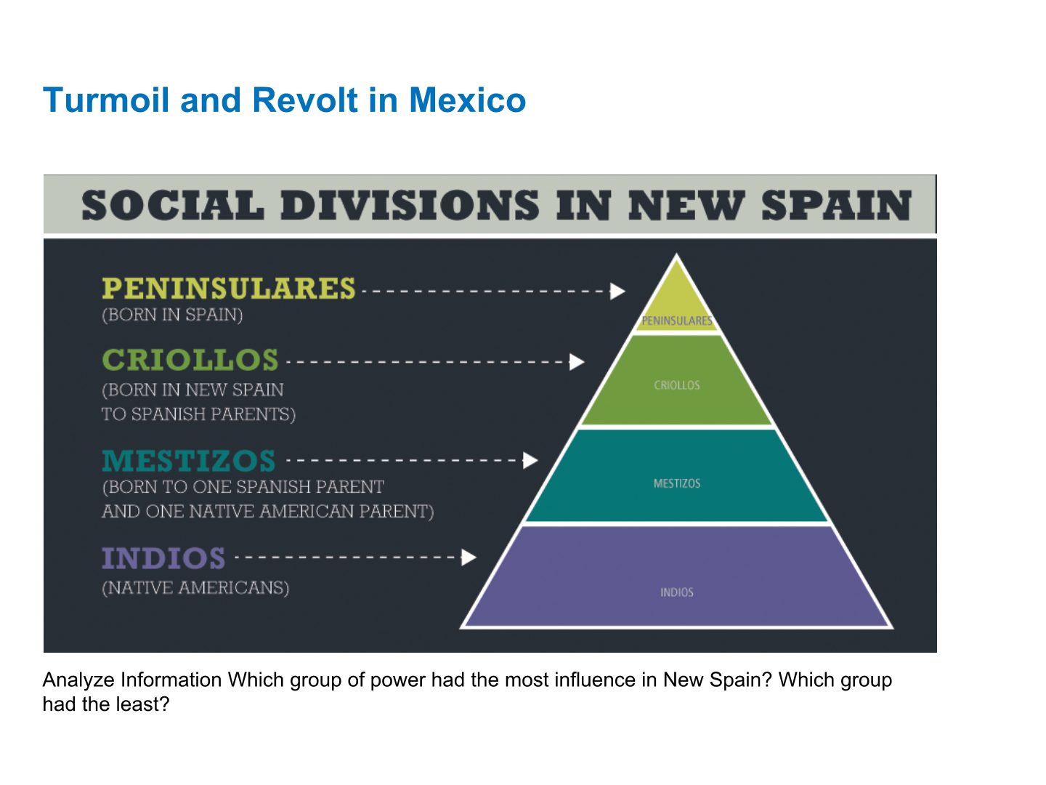

Slide 3




WHY INdEpENdENCE??
Cause #1: Mexicans did not like the inequality.
Spaniards who weren’t even from Mexico were put in charge of New Spain..
Spaniards got all the good jobs (power) and privileges (money $$$)

Slide 4

WHY INpEpENdENCE??
Cause #2: Spain raised the taxes (money you have to pay to government) in Mexico
Spain made the people in Mexico pay for wars going on in Europe!

Slide 5
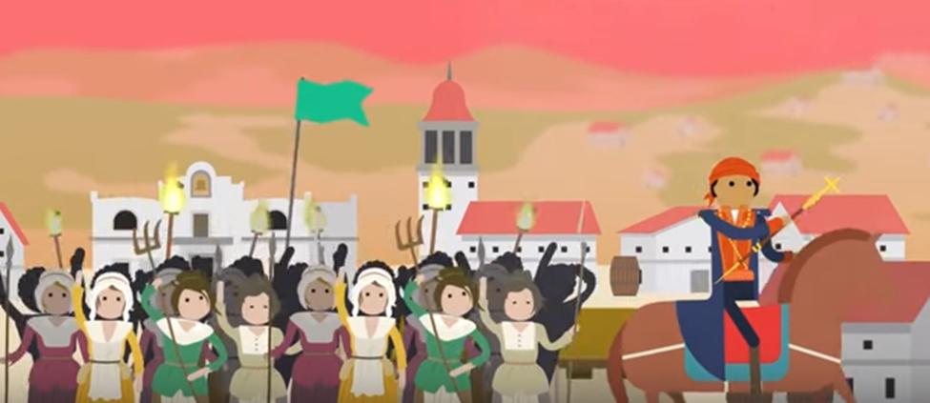
result → revolt and fight for independence against spain
What do you see? What do you think revolt might mean?

Slide 6
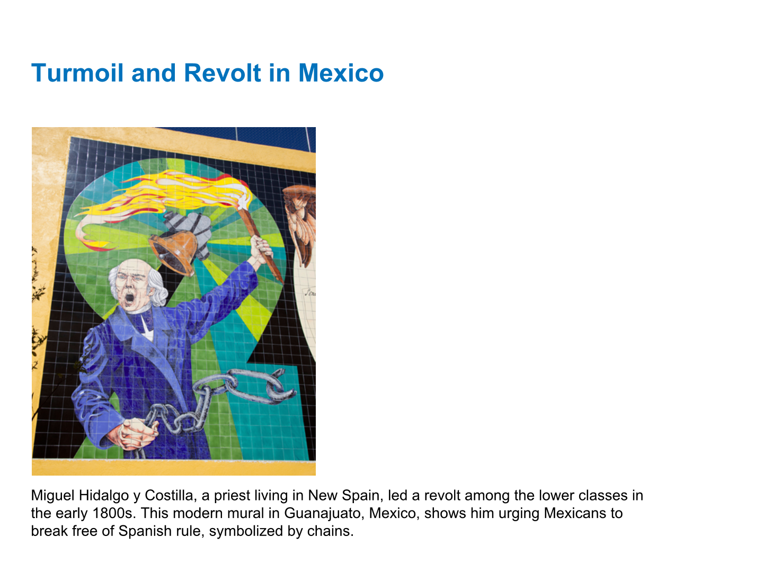
result → revolt and fight for independence against spain
What do you see? What do you think the chains might represent?

Slide 7
TIMELINE
1810
1812
Miguel Hidalgo calls for Mexicans to rebel against Spanish rule
1819
In Texas, Gutierrez and Magee lead a revolt against Spain and WIN!!
James Long, an American filibuster, tried to free Texas from Spain
Remember a Filibuster Is a person who starts an unofficial war on a country

Slide 8
MEXICO IS NOW Independent!
1821: Army led by Emperor Iturbide takes control of Mexico City

Slide 9
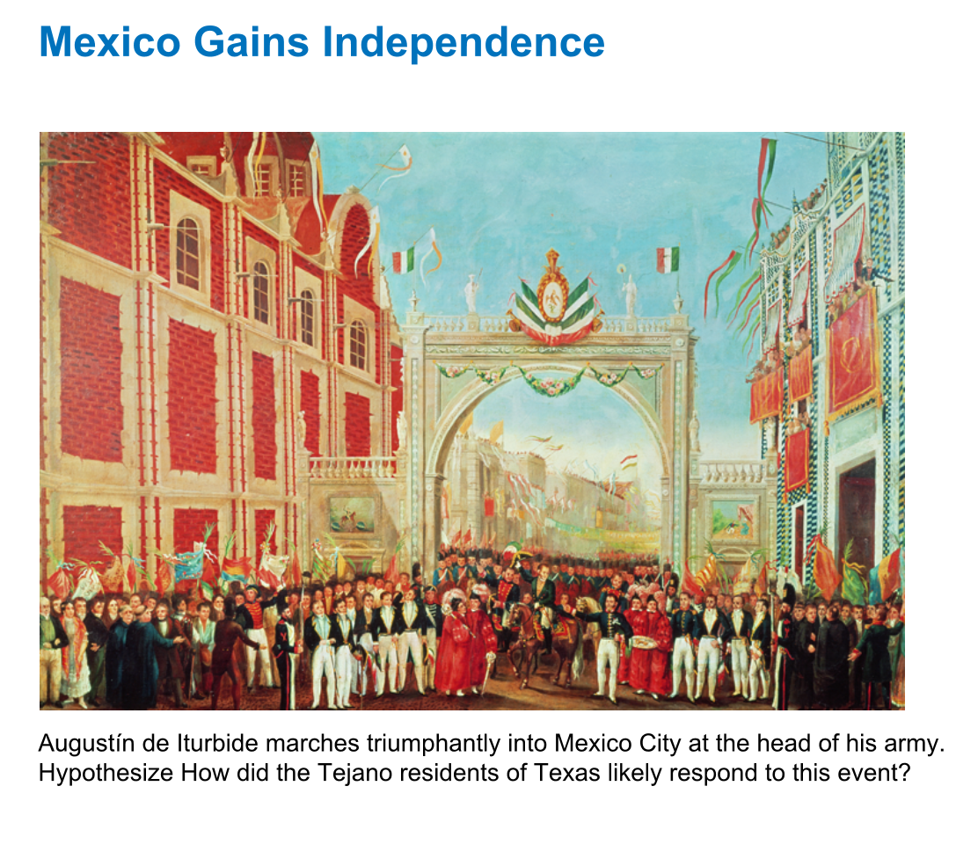
Mexican Victory

Slide 10
Results of Independence:
#1: Father Hidalgo became known as:
”Father of Mexican Independence”
#2: Texas becomes:
”Coahuila y Texas” (a Mexican state)
#3: Mexico must now:
Must rebuild their government
Constitution of 1824

